Slide 1

Node.js Garbage Collector
Tamar Twena-Stern

Slide 2
What Is a JavaScript Engine
A program which executes JavaScript code.
Can be implemented as
Interperter
JIT compiler
List of JavaScript Engine
V8
Rhino
SpiderMonkey
And more

Slide 3
Introduction to v8
An open source JavaScript engine
Written in c++ by Google
Used in Google chrome
Designed to increase JavaScript performance inside web browsers
Compiles a JavaScript code to machine code on execution (JIT compiler)
Does not produce any intermediate code

Slide 4
Evolution – v8 Adopted by Node.js
V8 was not designed for server
Built to power fast browsers
When it was ported to server, cam the understanding that it needs memory management

Slide 5
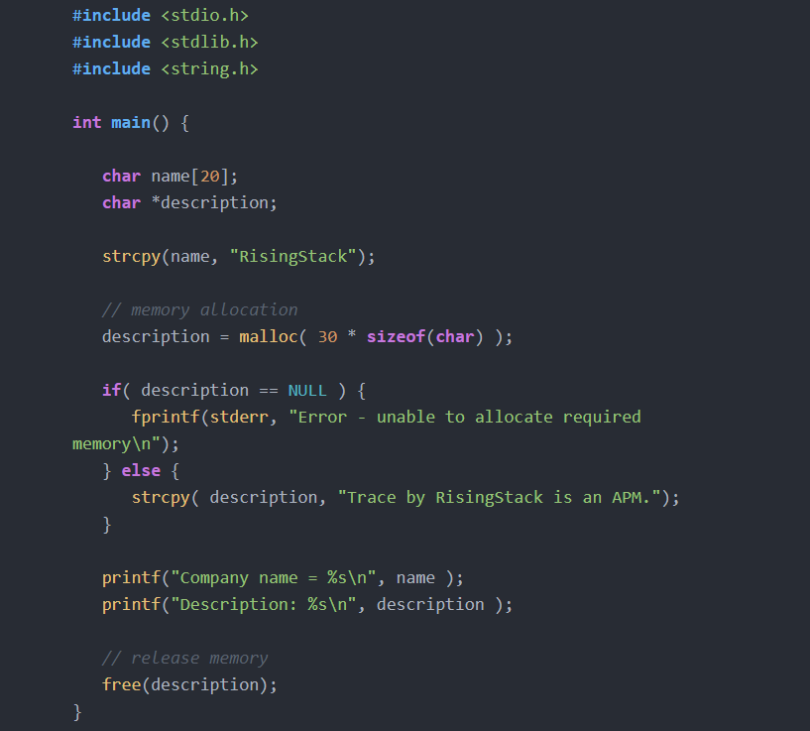
Manual Memory Management

Slide 6
Garbage Collection
Automatic memory management
Attempts to reclaim memory which not used by the program any more
Advantages
Provide developers huge simplification : They do not need to handle garbage collection themselves
Reduce memory leaks

Slide 7
V8 Memory Structure

Slide 8
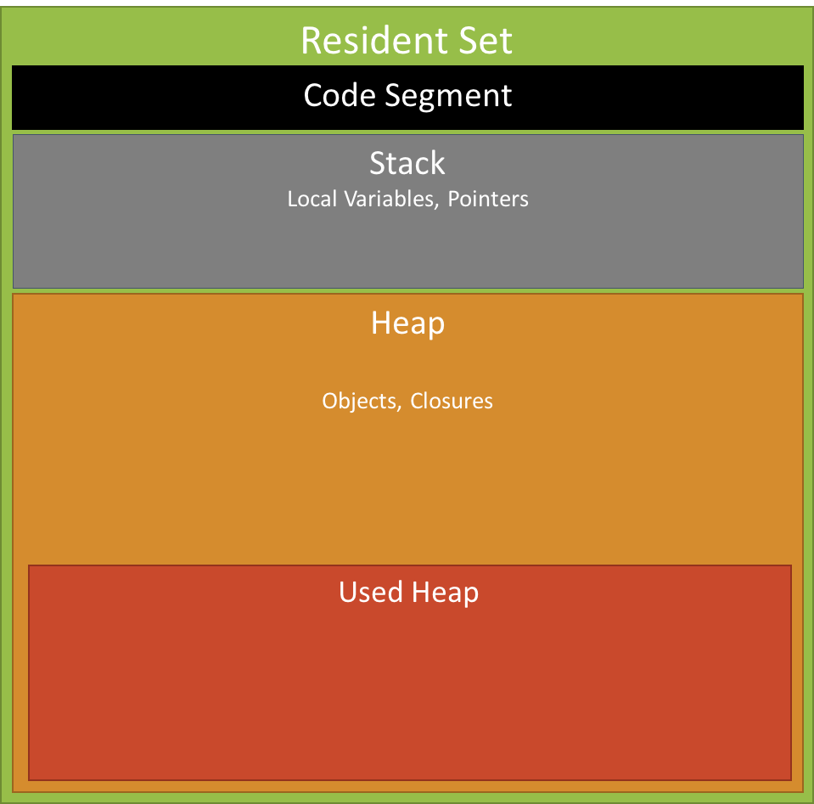
Memory Scheme Overview

Slide 9
Memory Scheme - Definitions
Resident Set (RSS) – The total portion of space that is occupied by a specific process
3 Segments–
Code – The actual code being executed
Stack –
all primitive value types (integer, boolean…)
pointers referencing objects on the heap
Heap – Storing reference types
Objects
Strings
closures

Slide 10
The Stack
LIFO data Structure
Every executing function pushes its local variables and arguments
Small size, very fast, extremely efficient
Maintains two pointers –
Stack Pointer – Points to last frame
Base Pointer – Points to base
Divided into stack frames
Stack frame - the area in the stack allotted to each function.
Each stack frame houses the calling function’s arguments, local variables and housekeeping data.

Slide 11
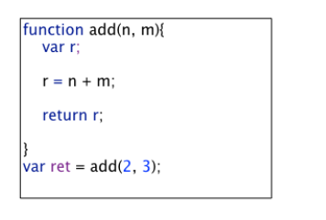
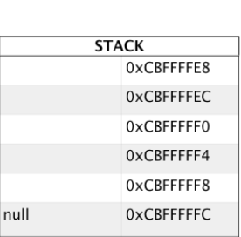
Stack - Concrete Example
Initial State
The base pointer is starting up -contains null.
The stack pointer is pointing to its latest push.
Each address slot in the stack is 4 bytes away from its immediate neighbor.
The highest address is at the bottom.
The stack pointer moves up, towards lower memory addresses.
Stack Pointer + Base Pointer

Slide 12
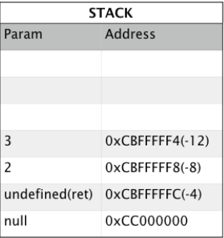
Stack – Concrete Example
Step – 2 - Preparation to call add :
Space is reserved for the return variable ret
Arguments n and m and set to values 2 and 3.
Note:
The stack pointer moved up after every push.
Each memory address is offset by 4 bytes from the base pointer
Stack Pointer
Base Pointer

Slide 13
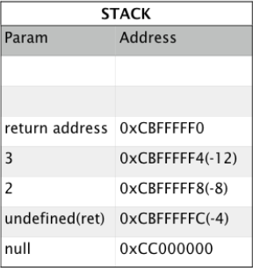
Stack – Concrete Example
Step – 3: Call Function add
The return address of add is saved(pushed).
The return address is the address where the function will return with the results.
Stack Pointer
Base Pointer

Slide 14
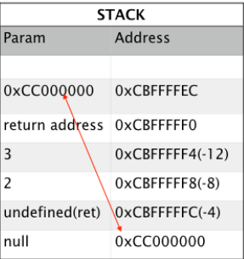
Stack – Concrete Example
Step - 4
Before starting to execute add the address of the old frame is first saved.
The base pointer moves to the new frame.
Note:
Stack also saves housekeeping data.
The housekeeping data consists of return address and the frame address.
Return address takes back the program where the program left off.
The frame address(value of base pointer) allows the stack to connect one frame with another.
Stack Pointer + Base Pointer

Slide 15
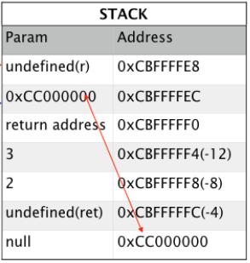
Stack – Concrete Example
Step – 5: On entering function add, space for variable r is reserved.
Note:
The stack frame consists:
The function arguments(2 and 3)
The address of the previous frame
The return address and the local variable r.
Stack Pointer
Base Pointer

Slide 16
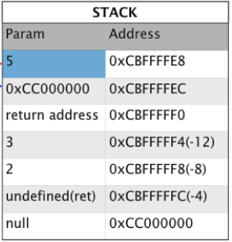
Stack – Concrete Example
Step – 6:
Addition of n and m is performed
The result of 5 is put into the variable r
Time to return to previous frame.
Items need to be popped off the stack
Back to previous frame
Stack Pointer
Base Pointer

Slide 17
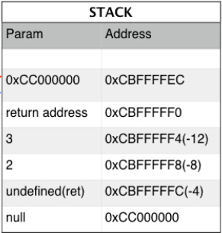
Stack – Concrete Example
Step – 7:
The result of 5 is popped off the stack
Result is held in a temporary register.
The stack pointer moves down using the return address.
Note:
The temporary register is located in the CPU.
Stack Pointer + Base Pointer

Slide 18
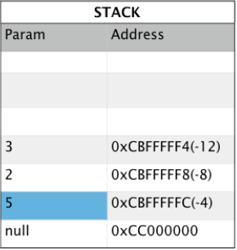
Stack – Concrete Example
Step – 8:
The saved address of the previous frame is popped off
The base pointer moves back to the previous frame.
The return address is popped off
Control is returned to module which called the program.
The result of 5 is put into the variable ret.
Stack Pointer
Base Pointer

Slide 19
Stack – Concrete Example
Step – 9:
The frame is now popped off
Stack is empty
The program terminates.
Note:
In reality the stack has frames for the calling module.

Slide 20
Summary
The stack is cleaning up after itself.
It does not need any garbage collection process.
The Stack does hold the key to the garbage collection process.
The Garbage Collection Process Start from the active objects and their pointers in the stack.

Slide 21
V8 Heap Structure
In order to understand how the garbage collector works in Node.js , we need to get to the detail of the heap structure.
The heap is constructed from the following parts :
New space
Old data space
Old pointer space
Large object space
Code space
Misc space

Slide 22
Heap – New Space
The heap “young generation” objects
Most objects are allocated there
Small space related to other heap portions
Designed to be garbage collected very quickly
The strategy –
Most objects will be deleted from new space
Only objects that survive the new space arrive to old space

Slide 23
Heap – Old Space
Most objects are moved here after surviving in new-space for a while.
Old Data Space –
Objects which contain raw data (no pointers).
Examples :
Strings
boxed numbers
arrays of unboxed doubles
Old Pointer Space
Objects which may have pointers to other objects.

Slide 24
Heap – Large Object Space
Contains objects which are larger than the size limits of other spaces.
Each object gets its own region of memory.
Large objects are never moved by the garbage collector.

Slide 25
Heap – Code Space And Misc Space
Code Space –
Code objects allocated there.
The only space with executable memory.
Misc Space - These include the
Cell space, property cell space and map space and they contain specialized data and pointers.
Garbage collection is not done on those areas

Slide 26
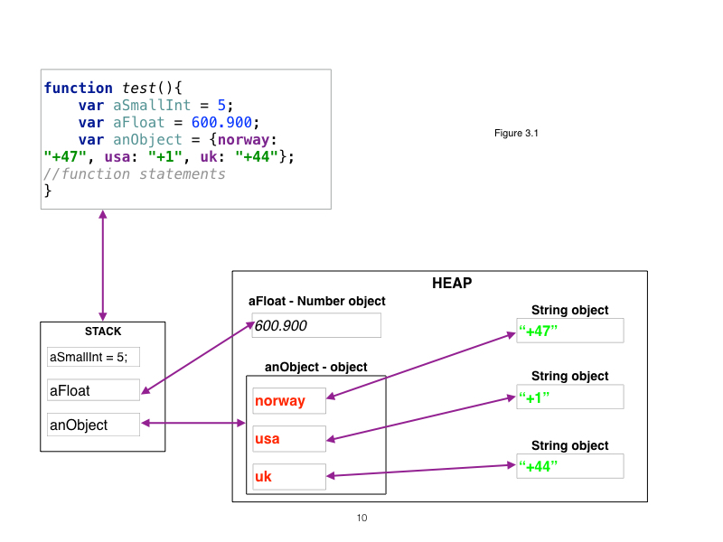
Concrete Example

Slide 27
Concrete Example - Continue
aSmallInt
Immediate 31-bit integer
Stored on the stack.
aFloat
Number object
Reference is stored on the stack
The number object stored on the heap.
anObject
Literal object.
Reference to this object is stored on the stack
Object itself is stored on the heap.

Slide 28
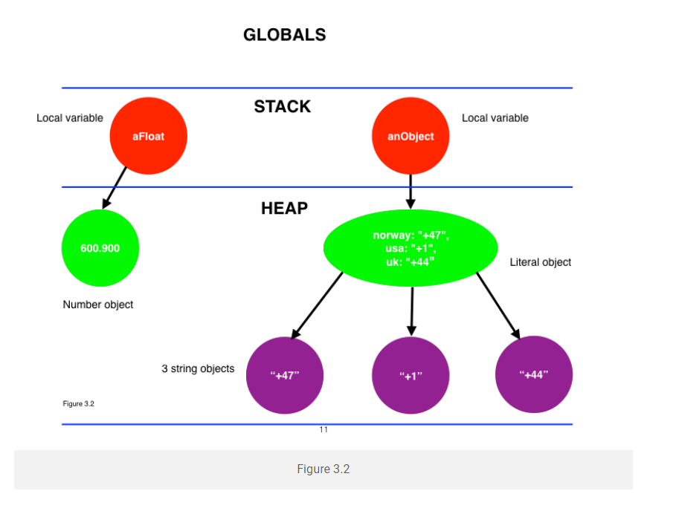
Concrete Example – Object Graph

Slide 29
Object Graph Explained
The stack references point to the objects on the heap.
While parameters of the function test exists on the stack
References exist on stack
The objects on the heap exist.
The objects in the heap are called live objects.
Once the function ends :
both the handles go out of scope
the objects in the heap are considered dead.
V8 can now reclaim the memory of the objects

Slide 30
Objects – Dead Or Alive
Live Object – An object which being referenced by a chain of live objecs to a root object which is live
Dead object – an object which has no references, or it’s references at the end arrive to another dead object.

Slide 31
Lets Do Exercise1.docx

Slide 32
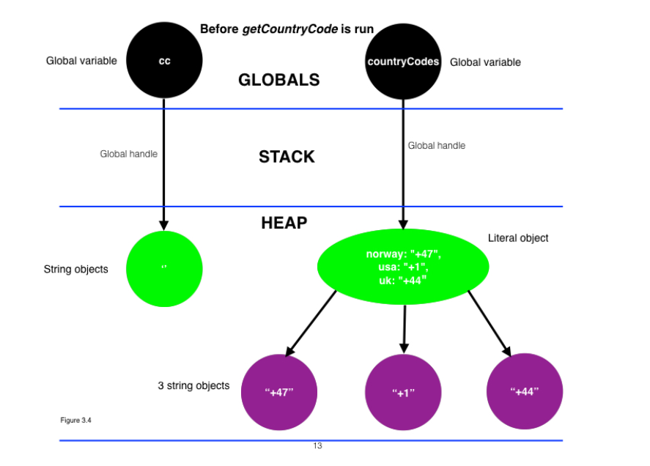
Exercise Solution – Object Graph Before The Function Begins

Slide 33
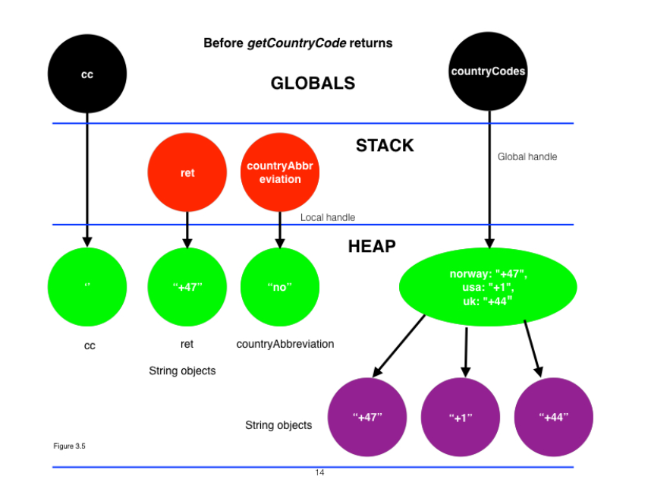
Exercise Solution – Object Graph While The Function Run

Slide 34
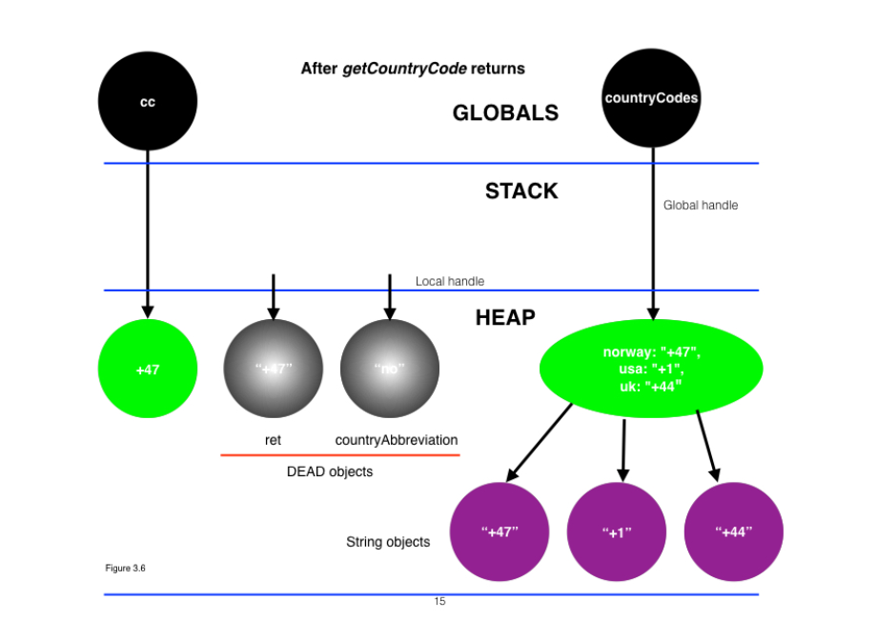
Exercise Solution – Object Graph After The Function Ends

Slide 35
Exercise Summary
countryCodes and cc are global variables and considered as root objects.
On entering getCountryCode:
Ret and countryAbbreviation stored on the heap with the references on the stack.
Both the local variables are considered root objects.
Live for the entire execution of the function.

Slide 36
Exercise Summary - Continue
When the function returns, the global variable cc contains the value of 47, the country code for Norway.
Both ret and countryAbbreviation are popped from the stack and discarded.
The references to the heap for ret and countryAbbreviation are removed and they considered dead.
Both globals are still live as they can be used again till the program terminates.

Slide 37
How The Garbage Collector Works

Slide 38
High Level Explanation – Reachability From Live Objects
A distinguished set of objects are reachable or in live scope.
Known as the “roots.”
Include
all the objects referenced from anywhere in stack
Any global variables.
Objects are kept in memory while they are accessible from roots
Can be accessible through a reference or a chain of references.

Slide 39
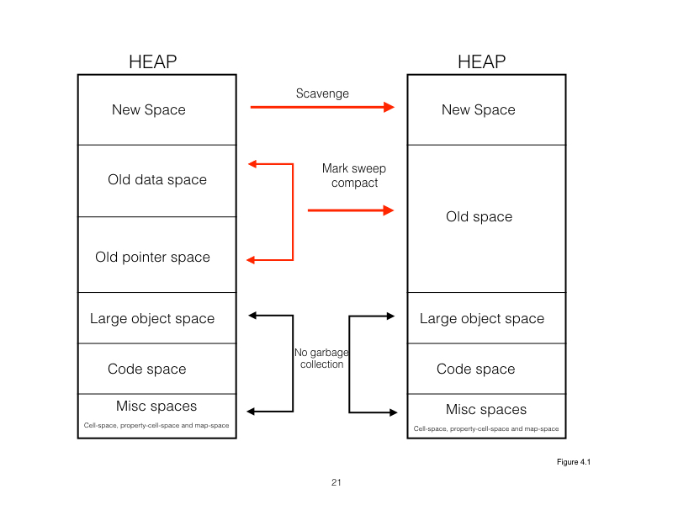
Garbage Collector Deep Dive

Slide 40
Generational GC System
Lifetime of objects determines their place on the heap
New Space – short lived Objects
Old Space – long lived Objects
Scan on ‘New Space’ called ‘Scavenge’
Very fast – takes less then a millisecond
Scan on ‘Old Space’ called ‘Mark Sweep’
Slower scan

Slide 41
Object Life On The Heap
Object Allocated On ‘New Space’
‘Scavenge’ Scan To Detect Live Objects On New Space
Object survives 2 ‘Scavenge’ scans and still alive
Moved to ‘Old Space’
more space is needed on old heap space
Mark Sweep Scan starting on old heap

Slide 42
Fragmentation On The Heap
Consequence of garbage collection.
Dead and live objects are Mixed in the heap.
If there are many ‘pockets’ of free memory exist:
allocation of new memory slow
objects would have to be split up for storage.
To fix - memory compaction
garbage collector moves objects around and lays them out in a contiguous memory space.

Slide 43
New Space - Scavenge Scan

Slide 44
Lets Do EX2

Slide 45
EX2 - Conclusions
Scavenge event, triggered as a result of allocation failure.
V8 ran out of memory in the new space
decided to reclaim dead space.
Each gc event time tends to increase.
There is a possibility of a leak.
V8 is finding it hard to gc.
The difference in size of before and after objects remains fairly constant.
The before and after overall memory size remains fairly constant.
This indicates that all of the dead space is being cleaned up.
If it did not, then this would be another indication of a leak

Slide 46
Scavenge Scan Deep Dive
Cheney’s Algorithm
New space is divided into two semi-spaces
To-space
From-space.
Memory Allocation Starts In ‘To Space’
‘To Space’ out of memory
GC event triggered
All memory copied to ‘From-Space’
Live objects copied to ‘To-Space’, Dead stay in ‘From-Space’

Slide 47
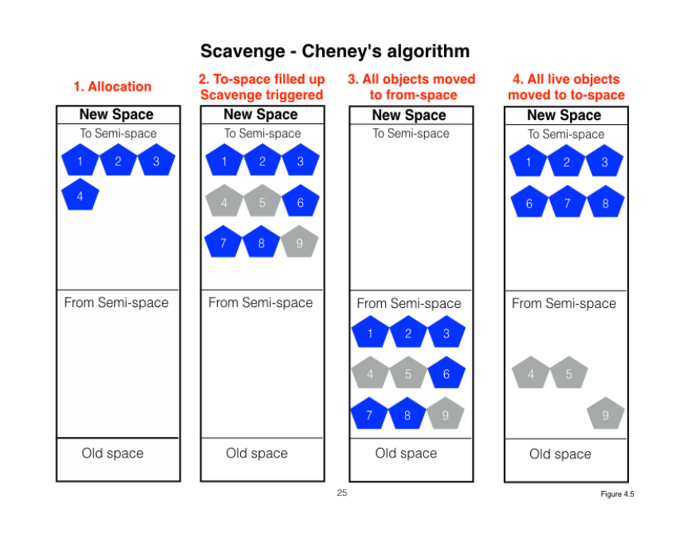
Scavenge Scan Deep Dive

Slide 48
Old Space – Mark Sweep + Mark Compact

Slide 49
Old Space – Mark Sweep + Mark Compact
Two phases:
Marking the live objects
Compacting – Get rid of dead objects, perform fragmentation if needed

Slide 50
Marking Phase
Locating and processing all the live objects.
Live Object - is referenced by some chain of pointers to a root object or another live object.
scanning, locating(discovering) and processing(marking) the live objects.
The garbage collector considers all the unmarked objects as dead.

Slide 51
Marking Phase Algorithm
done using tri color abstraction, where white, grey and black represent the marking states.
White – not visited
Grey – Visited, no information about their neighbors
Black – objects processed and live
Use DFS algorithm

Slide 52
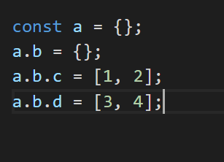
Concrete Example - Marking Phase

Slide 53
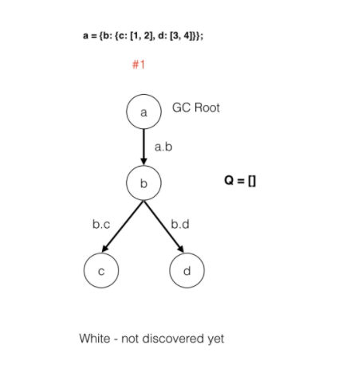
Concrete Example – Marking Phase
The initial object graph.
All objects are white as they have yet to be scanned.
The marker queue is empty

Slide 54
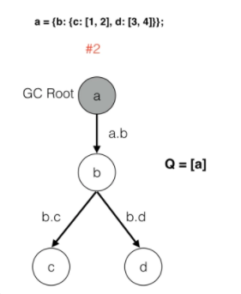
Concrete Example – Marking Phase – Step 2
The scan starts with the root which is the variable “a”.
“a” is marked grey and pushed to the queue.
Grey indicates that “a” has been discovered.
“a” has still to be fully processed – it’s neighbors(children) if any have yet to be discovered.
Marking Q = [a].

Slide 55
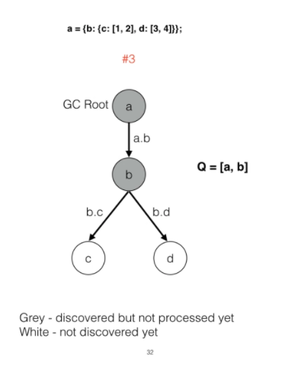
Concrete Example – Marking Phase – Step 3
Continuing with the depth search following edge a.b:
Object “b” is discovered
“b” marked grey
“b” pushed on to the marker queue

Slide 56
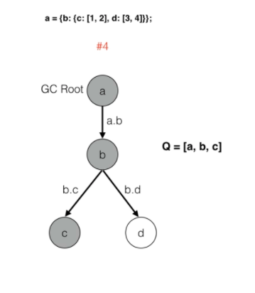
Concrete Example – Marking Phase – Step 4
The depth search continues and object “c” is discovered
It too is marked grey
Pushed to the queue
Q = [a, b, c].
Search stops as there is nothing beyond “c”(leaf).

Slide 57
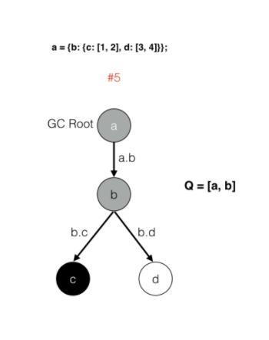
Concrete Example – Marking Phase – Step 5
Object “c” is popped from the queue
Marked black - fully processed.
It has been visited.
It has no neighbors.
It is live
Q = [a, b].

Slide 58
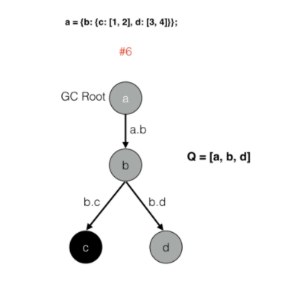
Concrete Example – Marking Phase – Step 6
the search continues by backtracking to the parent object “b”.
Continuing it identifies(discovered) object “d” a child of “b”.
Object “d” is now marked grey and pushed to the queue.
Q = [a, b, d].

Slide 59
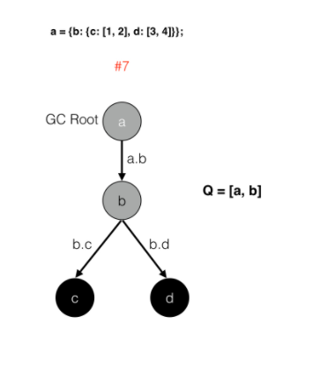
Concrete Example – Marking Phase – Step 7
Object “d” is popped from the queue
marked black -
fully processed.
It has been visited
It has no neighbors or children.
Q = [a, b].

Slide 60
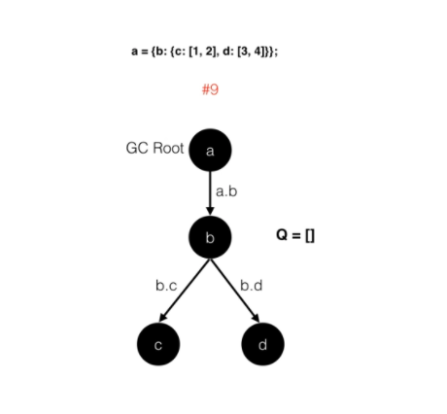
Concrete Example – Marking Phase – Step 8+9
backtracking to object “b”.
All its children(neighbors) have been processed
Considered fully processed
Popped and marked black.
Q = [a];
backtracking to object “a”
“a” marked as processed
All objects are live
No garbage collection

Slide 61
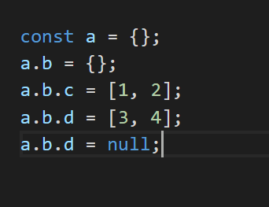
Lets Change The Code To Create Dead Object

Slide 62
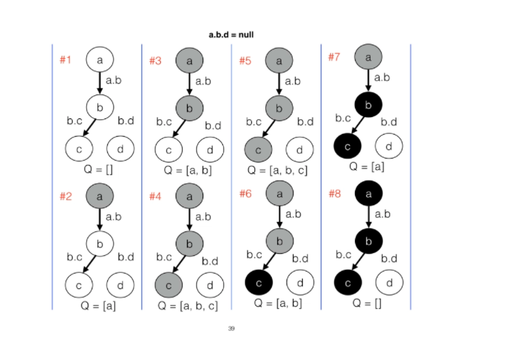
Marking Phase Flow – Dead Object

Slide 63
Summary - Marking
Once marking is complete V8 triggers a sweep event
The sweeper
Destroys all the unmarked (white) objects
Optionally compacts the fragmented live objects.
Old space could be very large in size.
It would take the collector hundreds of milliseconds to mark a large number of live objects.
Impact on performance – your program will be irresponsive

Slide 64
‘Stop The World’ GC
Event loop is single threaded
When GC works – The program stops
Can have performance impact if GC runs for long time
If your program is not responding – can be an indication for a memory leak

Slide 65
Lets Do EX3

Slide 66
Questions ?

